Slide 1
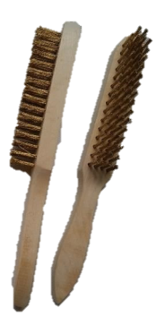
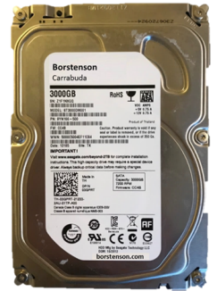

FACT SHEET
Hard-Disk Steel Brush
Series 105
Agile Dirt Array Protection System
Hard-Disc Steel Brush BOP.214.10501 - BOP.214.10509 series
Optimized for NAS enclosures with AgileBrushArray Multi-Dust-User technology for increased user workload rate Do more with up to 10TB (Terra Brushes) 24×7 always on, always accessible with NAS enclosures Best-Fit Applications: 1- to 8-bay network attached storage NAS, Desktop Dirt RAID and servers, Multimedia server storage, Private cloud Tough, ready and scalable, Borstenson SteelWolf Brushes (support up to 10TB) help to reduce downtime and ensure dust-free peak performance. Optimized for 1-to-8-bay NAS enclosures for home, SOHO and SMB use, SteelWolf drives are enhanced with AgileDirtArrayProtection technology and Rotational Vibration (RV)
Brush Drive Rotational Speed | 5900 RPM
Item Dimensions L x W x H | 5.79 x 4.01 x 1.03 inches
1 TB Steel Bristles | Item model number BOP.214.10501
2 TB Steel Bristles | Item model number BOP.214.10502
10 TB Steel Bristles | Item model number BOP.214.10509
Horst Thorsten BORSTENSON Brooms & Brushes Industries
FOR A DUST-FREE WORLD

